Slide 1
Employee Data Analysis using Excel
STUDENT NAME: K.KIRUTHIKA
REGISTER NO:312200254
DEPARTMENT: B.COM ACCOUNTING AND FINANCE (3RD YEAR)
COLLEGE: S.I.V.E.T COLLEGE

Slide 2
PROJECT TITLE
Employee Performance scorecard Analysis using Excel

Slide 3


AGENDA
Problem Statement
Project Overview
End Users
Our Solution and Proposition
Dataset Description
Modelling Approach
Results and Discussion
Conclusion
3/21/2024 Annual Review

Slide 4

PROBLEM STATEMENT
Develop an Excel-based Employee Performance Scorecard to standardize evaluations, track key metrics, and provide clear reports to improve decision-making on promotions, rewards, and development.

Slide 5

PROJECT OVERVIEW
.
This project develops an Excel-based Employee Performance Scorecard to evaluate performance using KPIs, weighted scoring, and visual charts. The scorecard enables consistent tracking, helping identify top performers and support decisions on promotions and development.

Slide 6

WHO ARE THE END USERS?
1. HR Managers 2. Team Leads/Managers 3. Senior Management 4. Employees

Slide 7

OUR SOLUTION AND ITS VALUE PROPOSITION
Conditional formatting – remove duplicate
Formula- performance
Filter- remove
Pivot table – summary
Charts and graphs –Data visualization

Slide 8
Dataset Description
Employee date set - kaggle
Emp id
First name
Last name
Business unit
Employee status
Employee type
Employee classification type
Department type
Division
DOB
Gender code
Performance score
Current employee rating
Performance level

Slide 9

THE "WOW" IN OUR SOLUTION
=IFS(M2>=5,”VERY HIGH”,M2>=4,”HIGH”,M2>=3,”MED”,TRUE,”LOW”)
3/21/2024 Annual Review
9

Slide 10
MODELLING
Graph:
To show the proportion of total compensation across different Performance score and overall analayze Conditional Formatting: Apply conditional formatting to highlight certain duplicate in date of birth Pivot Table: 1) Go to Insert > PivotTable. 2 )Choose the data range and where you want the PivotTable to be placed. 3 )Drag fields into Rows, Columns, and Values areas to analyze data.
Formula:
=IFS(M2>=5,”VERY HIGH”,M2>=4,”HIGH”,M2>=3,”MED”,TRUE,”LOW”)
For calculating performance level from Current employee rating
10

Slide 11
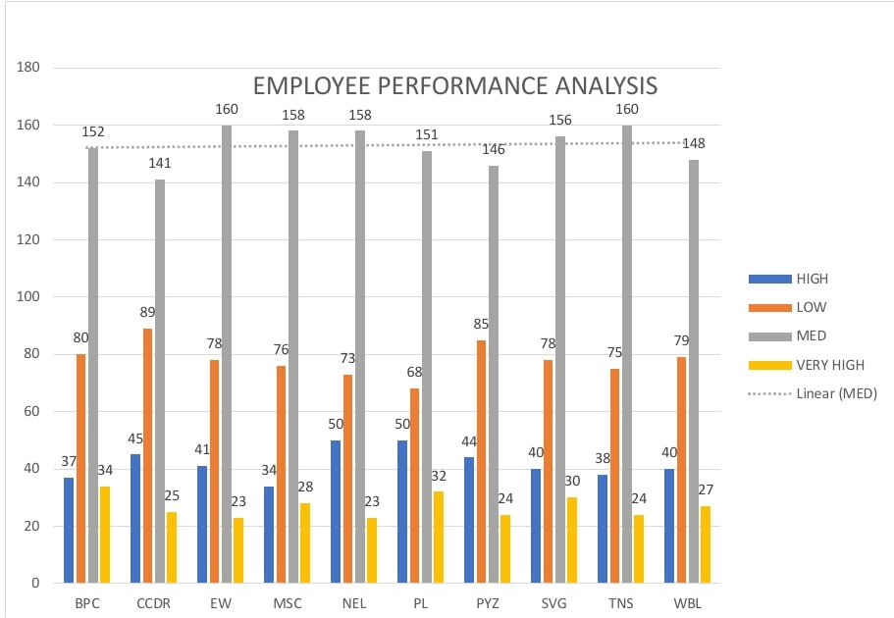
RESULTS
11

Slide 12
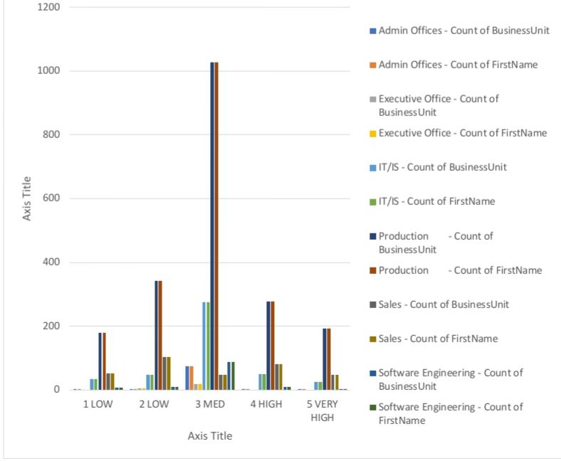

Slide 13
conclusion
The Employee Performance Scorecard effectively uses Excel tools like Pivot Tables for data summarization, Conditional Formatting for highlighting duplication, Formulas for accurate calculations, Filters for focused analysis, and Charts/Graphs for visual representation. Together, these tools enable a comprehensive and efficient performance evaluation, supporting data-driven decision-making.

